Slide 1
Week 8
Alexey V. Zimin
JHU BME 580.417/707

Slide 2
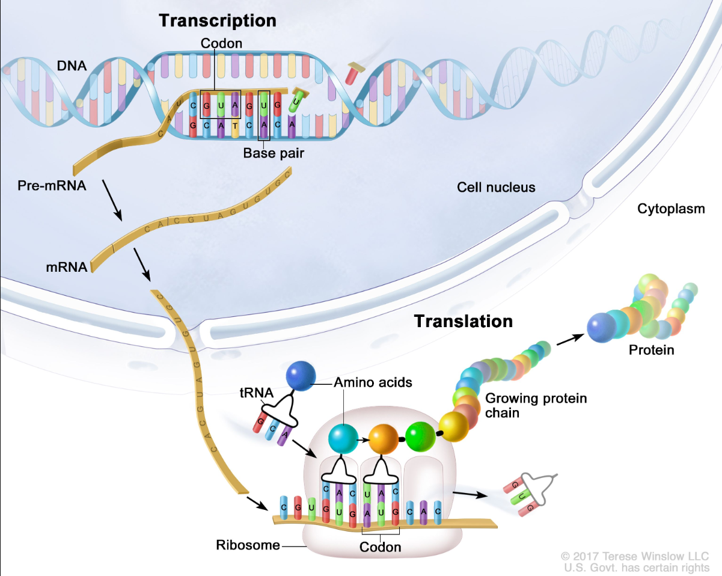
How transcription + translation works?
Transcription and translation are processes a cell uses to make all proteins the organism needs to function from information stored in the sequence of bases in DNA
Pre-mRNA has introns
mRNA has introns spliced out
Transcript is mRNA with T(Thymine) replaced by U(Uracil)
Notes:
Transcription and translation are processes a cell uses to make all proteins the body needs to function from information stored in the sequence of bases in DNA. The four bases (C, A, T/U, and G in the figure) are the building blocks of DNA and RNA. During transcription, a piece of DNA that codes for a specific gene is copied into messenger RNA (mRNA) in the nucleus of the cell. The mRNA then carries the genetic information from the DNA to the cytoplasm, where translation occurs. During translation, proteins are made using the information stored in the mRNA sequence. The mRNA attaches to a structure called a ribosome that can read the genetic information. As the mRNA passes through the ribosome, another type of RNA called transfer RNA (tRNA) carries a protein building block called an amino acid to the ribosome. The tRNA carrying the amino acid binds to a matching sequence in the mRNA. As each tRNA binds to the mRNA strand, the amino acid it carried joins with the other amino acids to form a chain of amino acids. Once all of the amino acids coded for in the piece of mRNA have been linked, the completed protein is released from the ribosome.

Slide 3
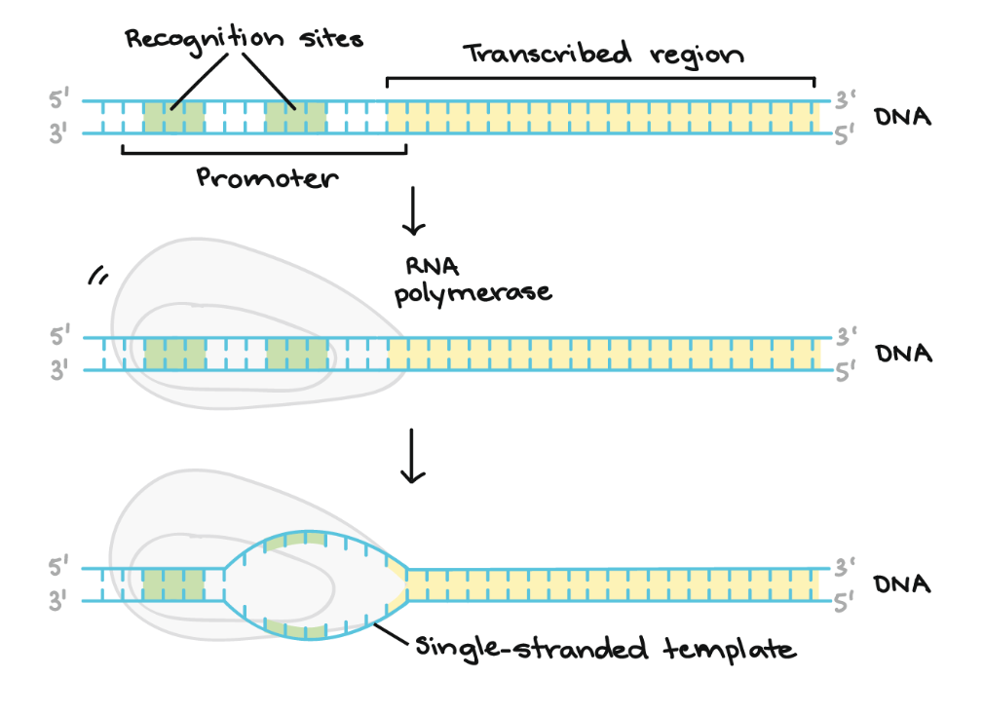
Transcription -- initiation
Transcription is the first step in gene expression. The goal of transcription is to make an RNA copy of a gene's DNA sequence. Eukaryotic transcripts need to go through some processing steps before translation into proteins.
The main enzyme involved in transcription is RNA polymerase, which uses a single-stranded DNA template to synthesize a complementary strand of RNA.
RNA polymerase builds an RNA strand in the 5' to 3' direction, adding each new nucleotide to the 3' end of the strand.
Image credit: Khan Academy

Slide 4
Transcription -- initiation
RNA polymerase binds to a sequence of DNA called the promoter, found near the beginning of a gene.
Each gene (or group of co-transcribed genes, in bacteria) has its own promoter.
Once bound, RNA polymerase separates the DNA strands, providing the single-stranded template needed for transcription.
Image credit: Khan Academy

Slide 5
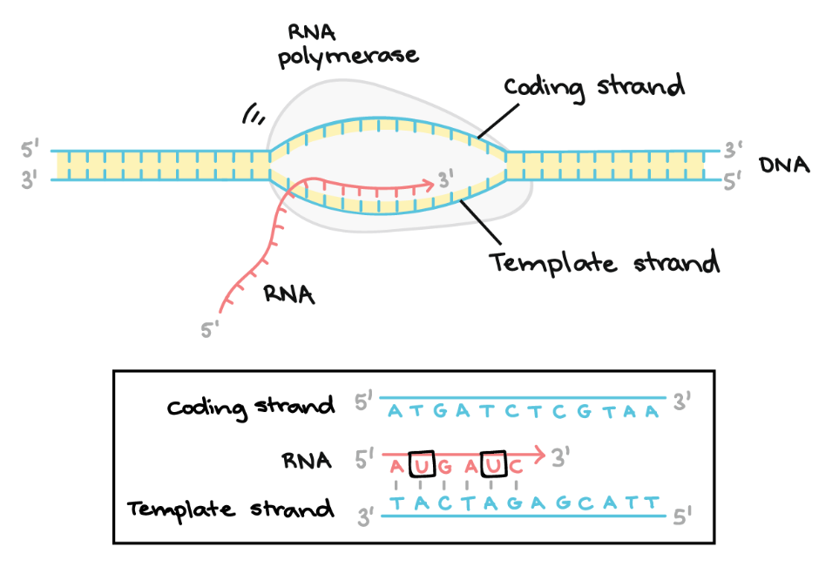
Transcription -- elongation
One strand of DNA, the template strand, acts as a template for RNA polymerase.
As it "reads" this template one base at a time, the polymerase builds an RNA molecule out of complementary nucleotides, making a chain that grows from 5' to 3’.
The RNA transcript carries the same information as the non-template (coding) strand of DNA, but it contains the base uracil (U) instead of thymine (T).
Image credit: Khan Academy

Slide 6
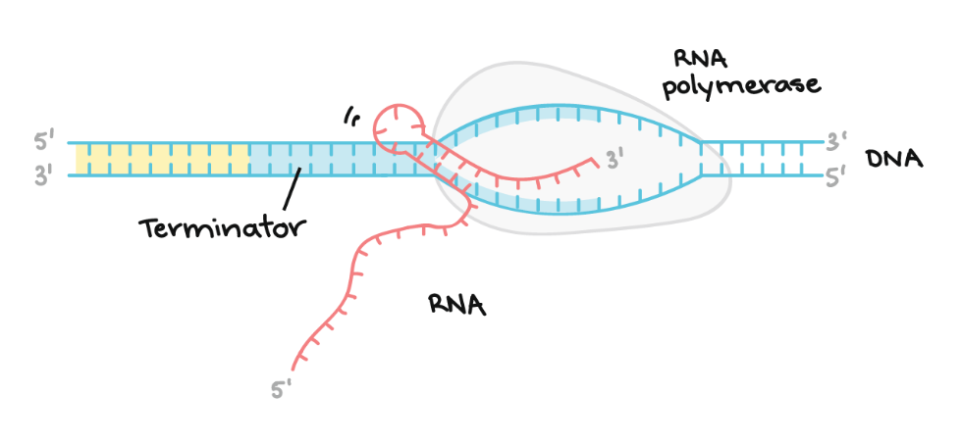
Transcription -- termination
Sequences called terminators signal that the RNA transcript is complete. Once they are transcribed, they cause the transcript to be released from the RNA polymerase.
An example of a termination mechanism involving formation of a hairpin in the RNA is shown here.
Image credit: Khan Academy

Slide 7
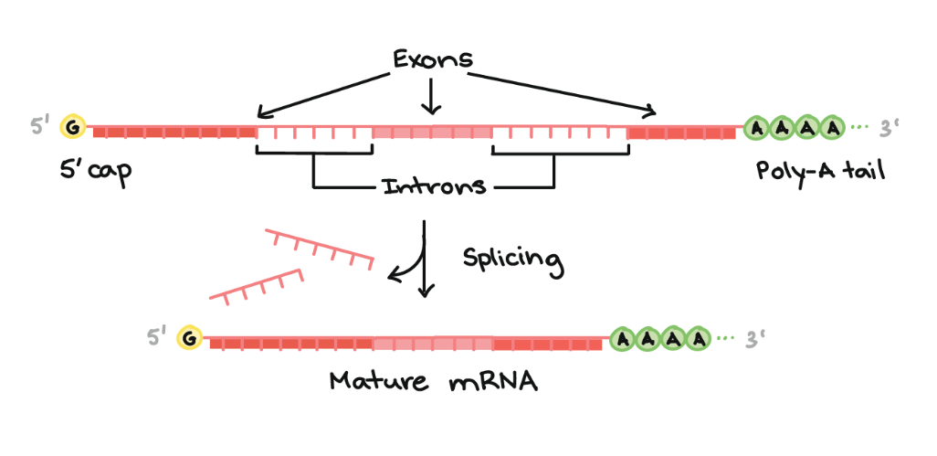
Transcription -- splicing
Eukaryotic pre-mRNAs must have their ends modified, by addition of a 5' cap (at the beginning) and 3' poly-A tail (at the end).
Many eukaryotic pre-mRNAs undergo splicing. In this process, parts of the pre-mRNA (called introns) are chopped out, and the remaining pieces (called exons) are stuck back together.
Image credit: Khan Academy

Slide 8
Poly-A tail
The poly-A tail is a long chain of Adenine nucleotides that is added to a messenger RNA (mRNA) molecule during RNA processing to increase the stability of the molecule
Processing of the 3' end adds a poly-A tail to the RNA molecule that is between 100 and 250 A’a long
Poly-A tail allows the mature messenger RNA molecule to be exported from the nucleus and translated into a protein by ribosomes in the cytoplasm

Slide 9
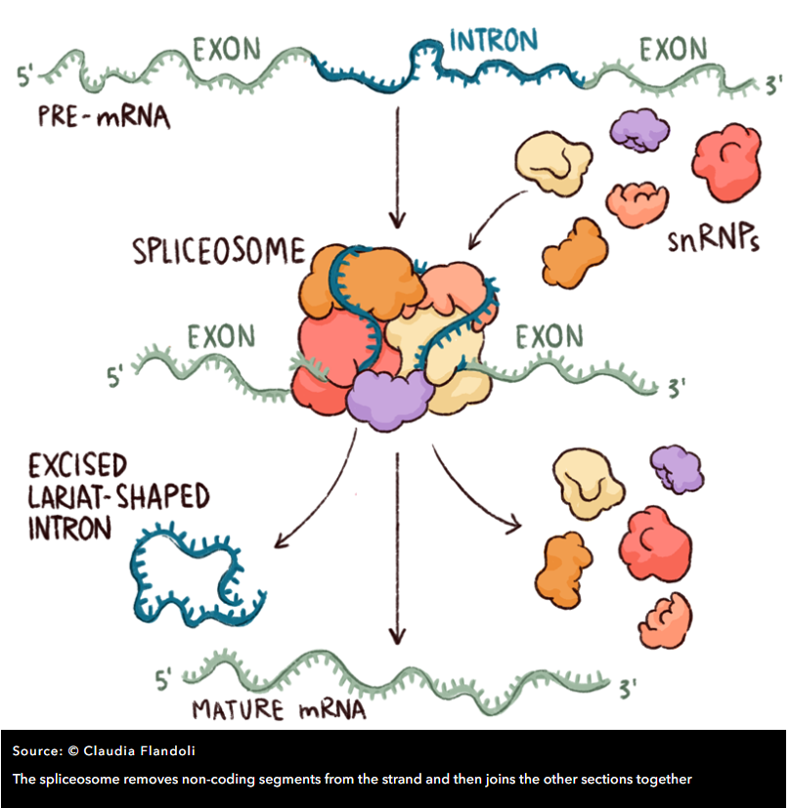
Splicing
Spliceosome includes five so-called ‘small nuclear ribonucleoproteins’ (snRNPs, often pronounced ‘snurps’) and numerous associated proteins.
The snRNPs contain RNA that is rich in Uracil, the RNA base that replaces DNA’s Thymine, and they are named – perhaps unimaginatively – U1, U2, U4, U5 and U6
Spliceosome determines the start and end of an intron by detecting DNA patterns around donor (typically GT) and acceptor (typically AG) sites

Slide 10
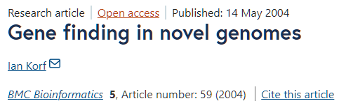
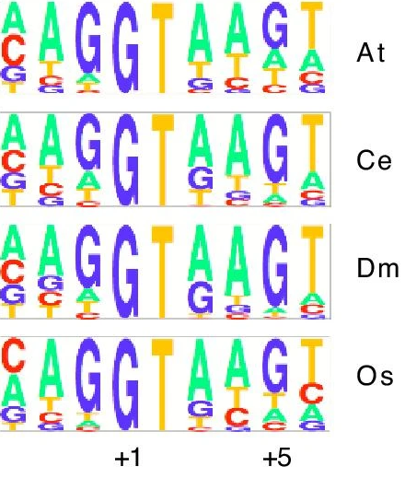
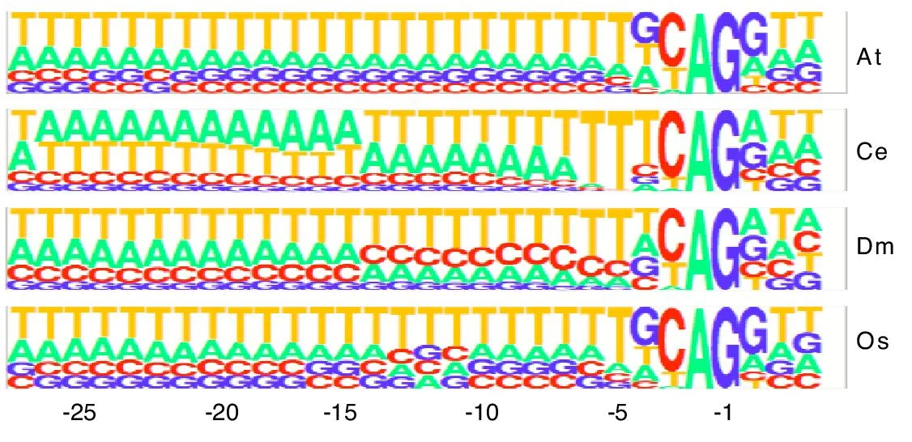
Splice site patterns
Donor (GT)
Acceptor (AG)

Slide 11
What goes wrong in transcription
Biochemical processes are not exact
RNA polymerase recognizes promoter sites imperfectly
More than 50% of the distinct transcripts are produced in error -- “transcriptional noise”
  Small portion of overall transcripts
  Generally expressed at a low level
  Never coding, recycled in cytoplasm
Introns are sometimes spliced imperfecty
  This is called intron retention
Splicing errors
Image credit: Khan Academy

Slide 12
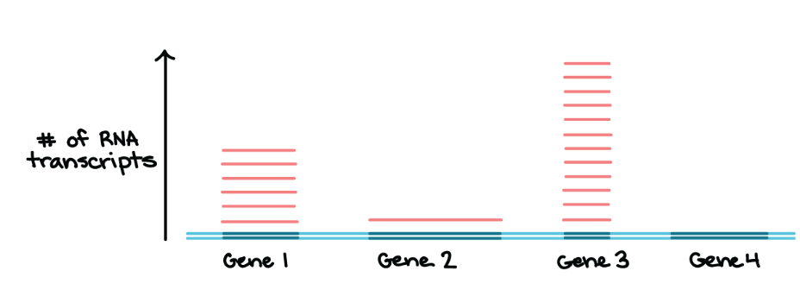
Transcription levels
Transcription levels vary a lot for individual genes
Transcript present is many copies != it is functional!
Image credit: Khan Academy

Slide 13
Translation: how proteins are made
Translation involves “decoding” a messenger RNA (mRNA) and using its information to build a polypeptide, or chain of amino acids. For most purposes, a polypeptide is basically just a protein (with the technical difference being that some large proteins are made up of several polypeptide chains).
In an mRNA, the instructions for building a polypeptide come in groups of three nucleotides called codons. Here are some key features of codons to keep in mind as we move forward:
  There are 61 different codons for 20 amino acids
  Three “stop” codons mark the polypeptide as finished
  One codon, AUG (ATG in transcript), is a “start” signal to kick off translation (it also specifies the amino acid methionine)

Slide 14
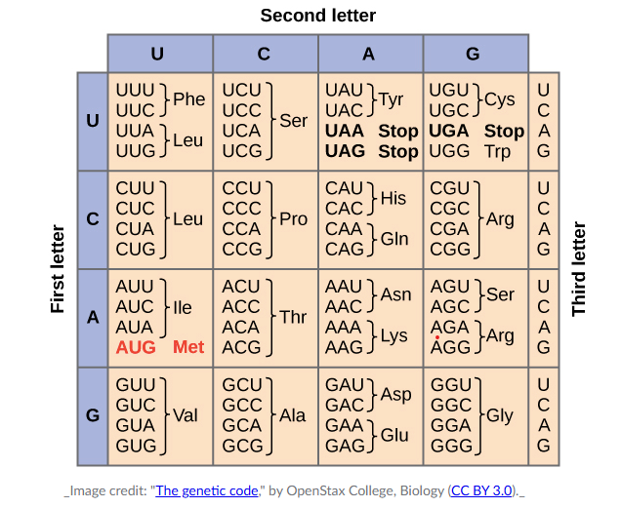
Codon table

Slide 15
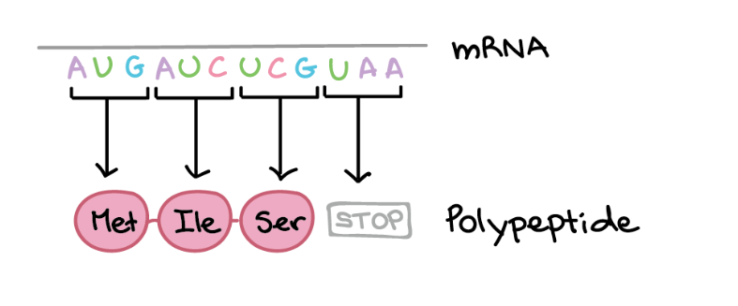
Stages of translation
Initiation ("beginning"): in this stage, the ribosome gets together with the mRNA and the first tRNA so translation can begin.
Elongation ("middle"): in this stage, amino acids are brought to the ribosome by tRNAs and linked together to form a chain.
Termination ("end"): in the last stage, the finished polypeptide is released to go and do its job in the cell.
Image credit: Khan Academy

